Slide 1
Well 16A(78)-32 UTAH FORGE HFTO Graphs
Isaac Xu: BSc Petroleum Engineering (Austin, TX)
December 18th, 2025

Slide 2
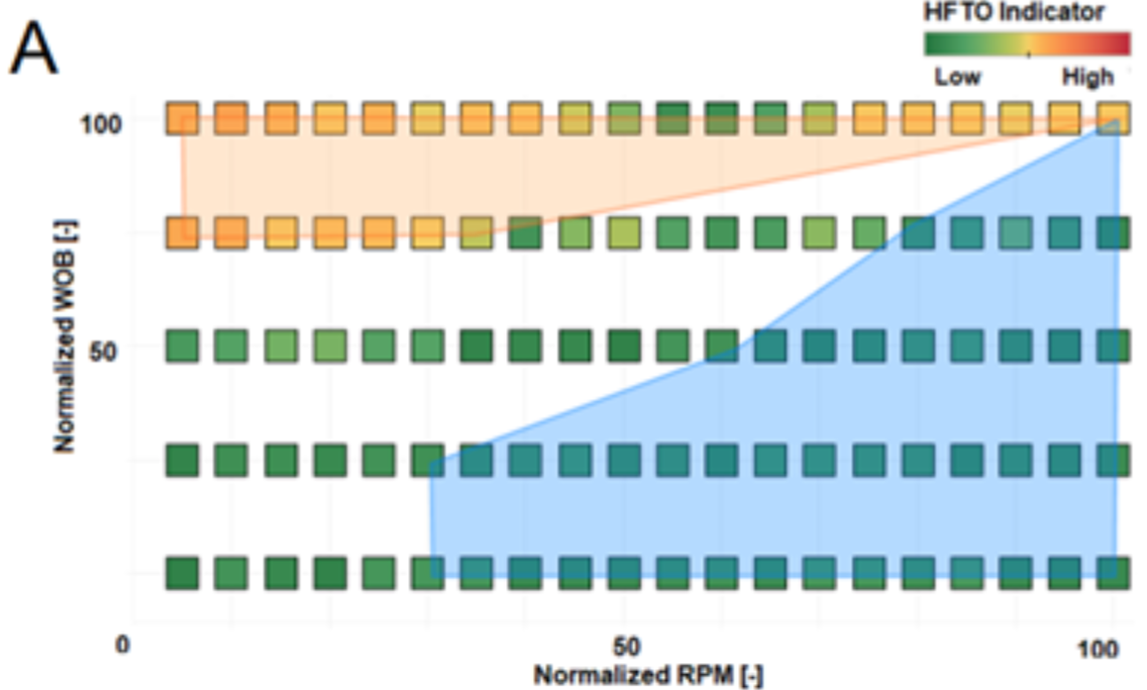
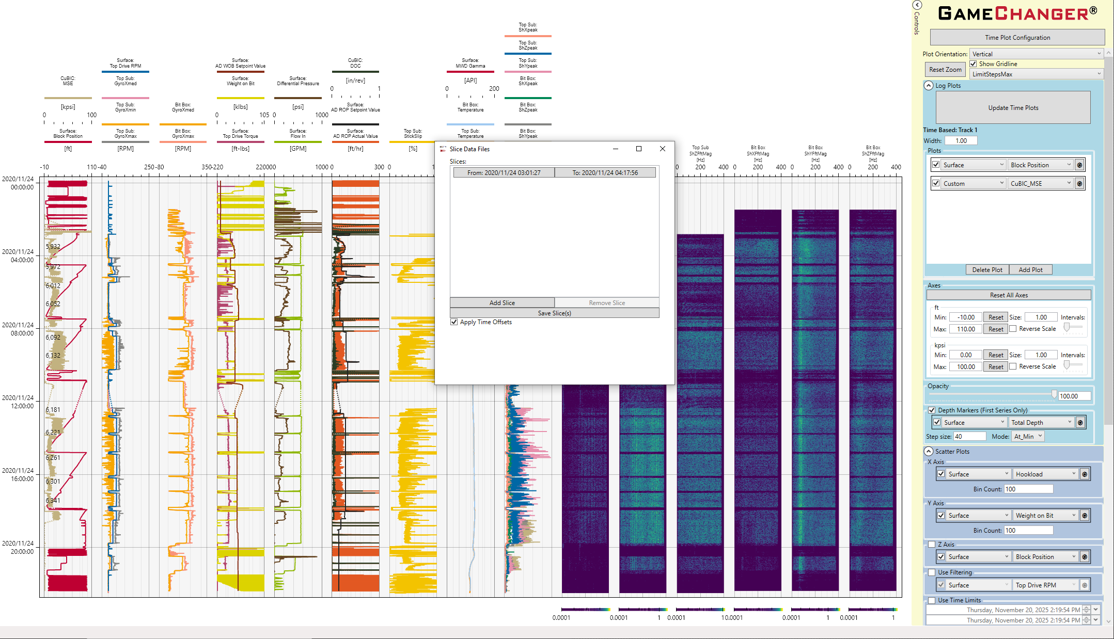
Data Collection
GameChanger has a slicing feature that allows precise time slicing HOWEVER does not contain vibration data
BUT there is a 1s data csv attached to every BHA, which will be what we use
We will bin the vibration data by WOB and RPM

Slide 3
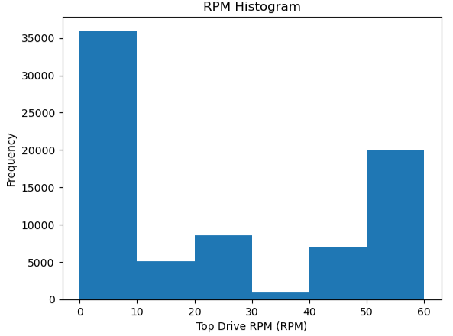
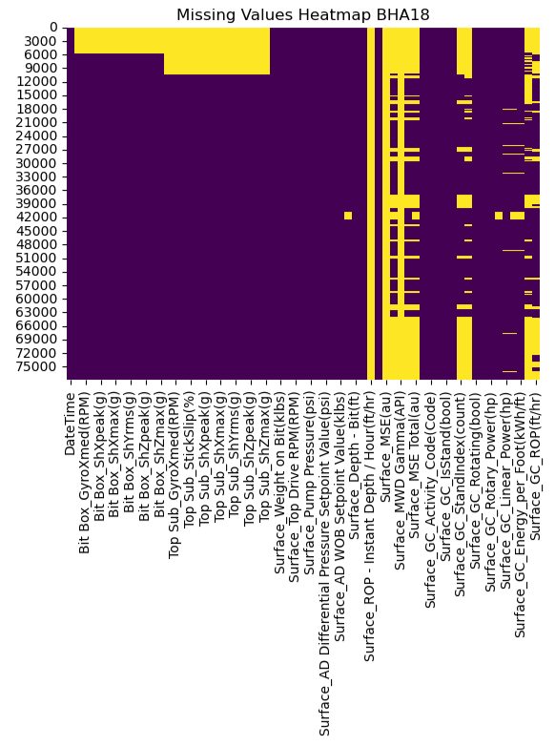
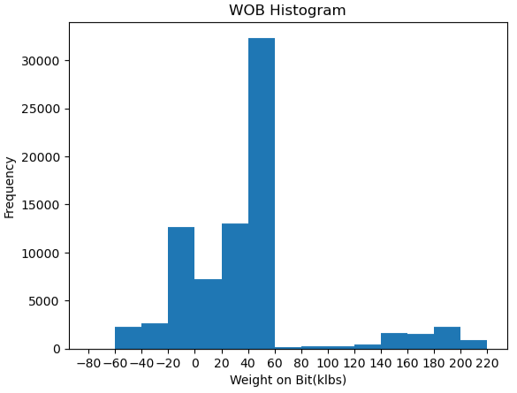
Data Exploration
First isolate the drilling data that has accompanying high frequency vibration data
Cut off the end of WOB above 100 klbs, this is unrealistic and probably represents unusual drilling phenomena then data
Negative values for both shock and WOB and RPM were also removed

Slide 4
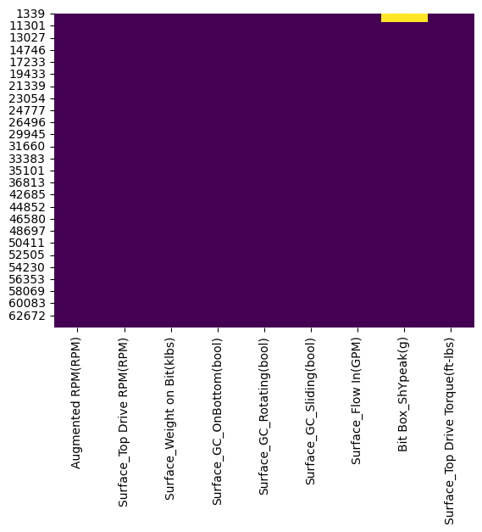
Missing Data Values and Augmenting RPM
Isolated the relevant columns and calculated Augmented RPM
We can multiply mud motor by flow in and add to top drive RPM to find bit RPM
Scout (the mud motor manufacturer for this BHA) has specification sheets, for this BHA's mud motor specifications was 0.242revs/gal
After isolated 10 < WOB < 100 and 10< Augmented RPM we get 43,268 rows

Slide 5
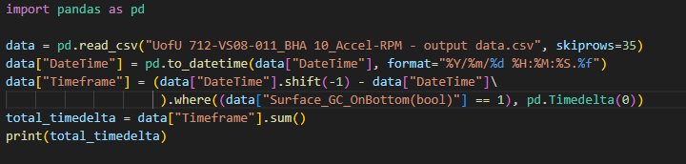
Manual ROP Calculations
BHA09 (13 fph in document), drilled 232ft in 23.21 hours (start: 11/14/2020 11:58:42PM, end: 11/15/2020 11:11:22PM) or 9.99 fph, using the python script to the right, calculated to be 14.37 fph
BHA10 (13 fph), drilled 124ft in 11.9 hours or 10.42 fph, using python: 15.03 fph
BHA14 (8.7 fph), drilled 342ft in 43.94 hours or 7.78 fph, using python: 12.44 fph
Surface_GC_OnBottom(bool)
False
True
Timeframe = 0
Timeframe = next row – current row

Slide 6
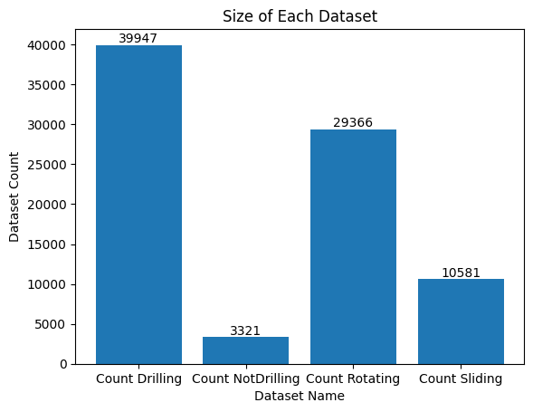
Drilling, Non-Drilling, Rotating, Sliding
The dataset gives us bools for this data, and we can split the data into 4 categories:
Drilling
Non-Drilling
Rotating
Sliding
We can now bin the data and make the HFTO graph
Since non-drilling data is low count, a meaningful analysis of this data may not be helpful

Slide 7
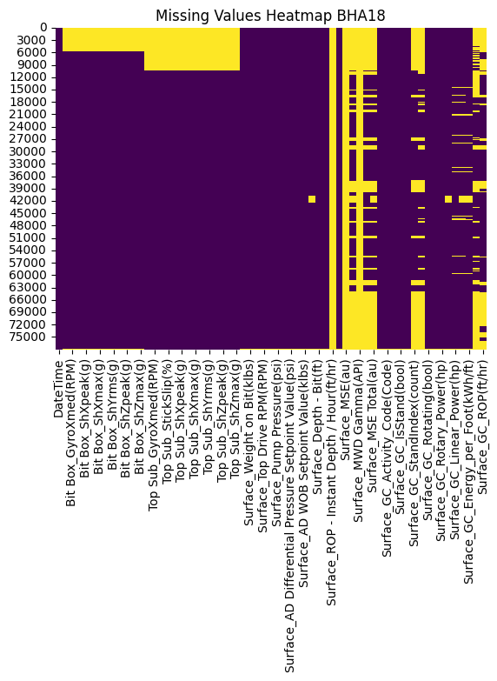
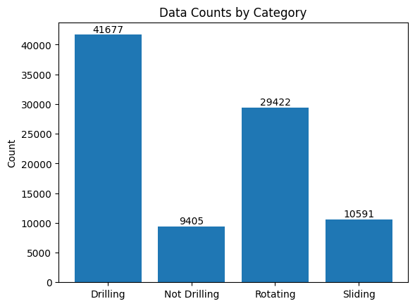
BHA18 Data Exploration

Slide 8
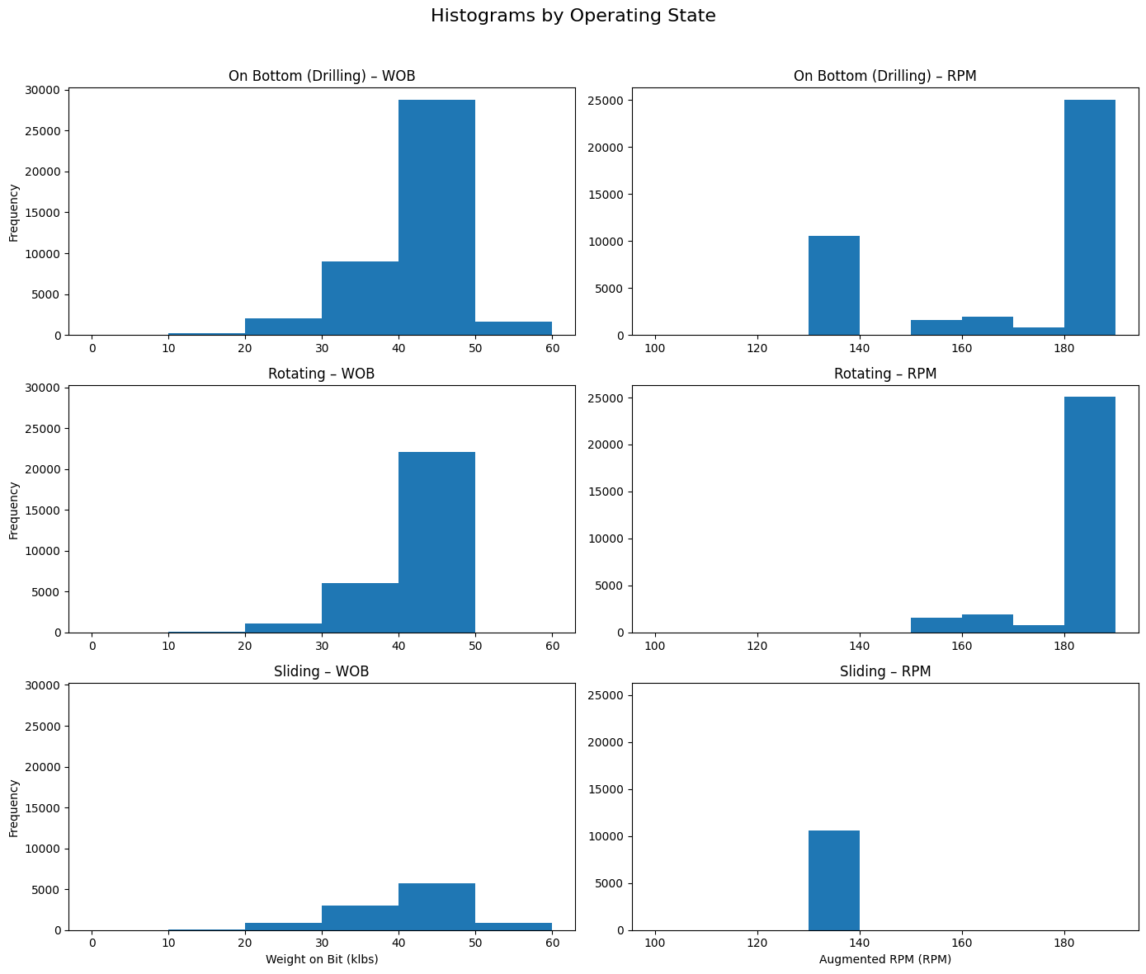
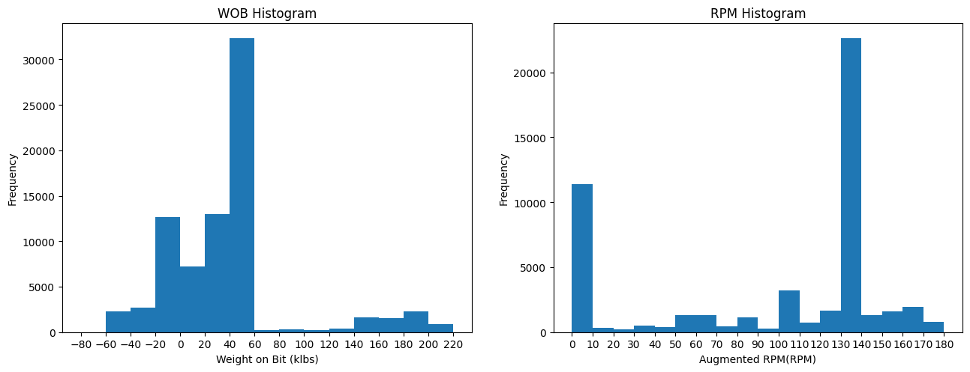
BHA18 Data Exploration

Slide 9
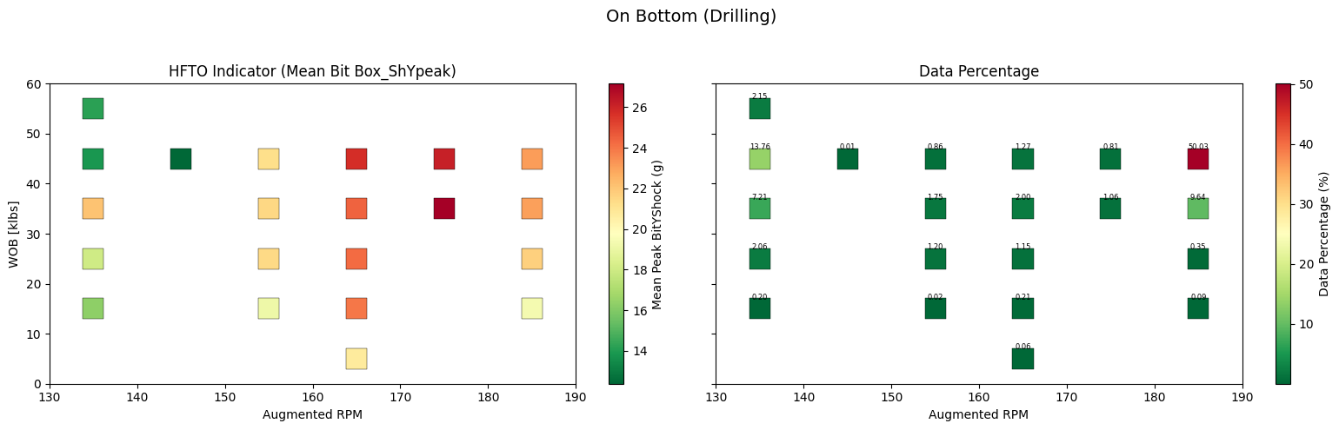
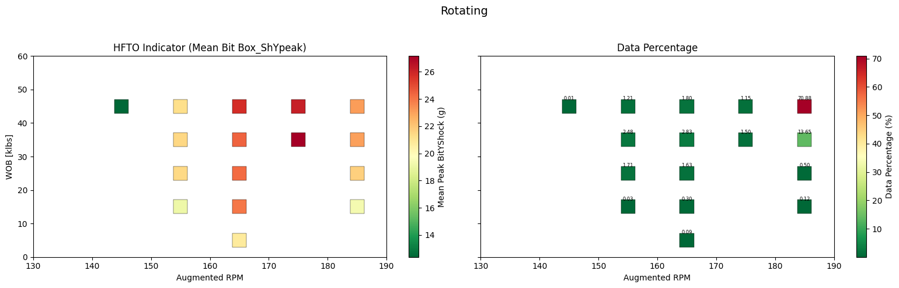
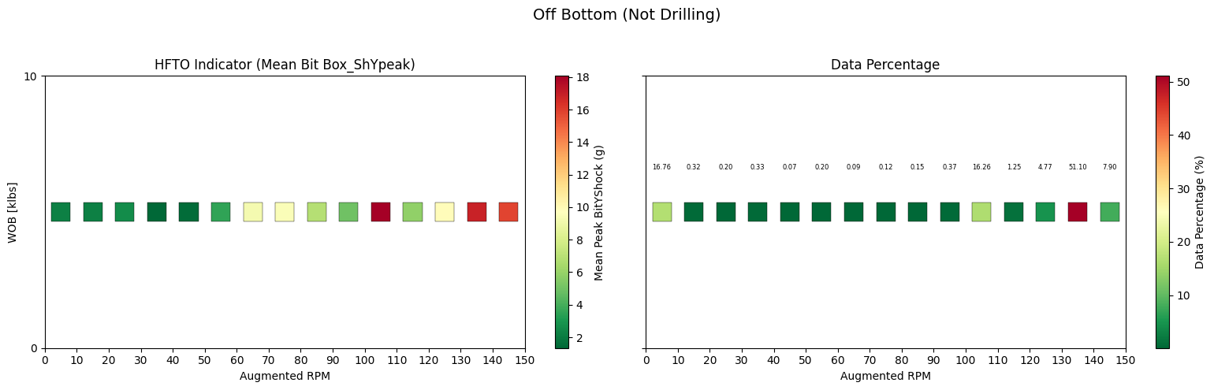
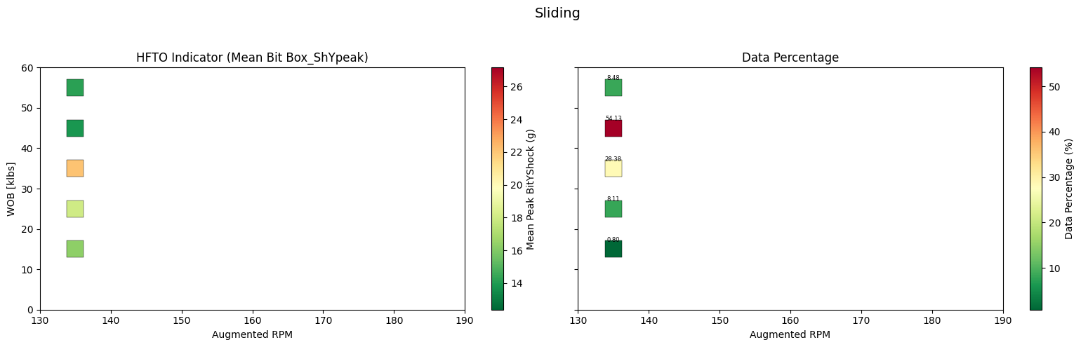
BHA18 HFTO Graphs
Sliding and rotating runs are totally isolated in terms of common WOB and RPM bins
When rotating off bottom, RPM > 100 seems conducive to HFTO’s
RPM from 170-180 are correlated to high HFTO’s but >180 RPM and HFTO magnitudes abate somewhat

Slide 10
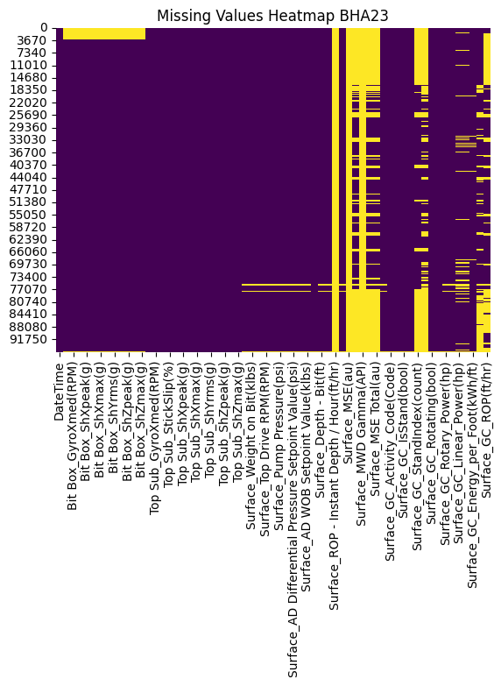
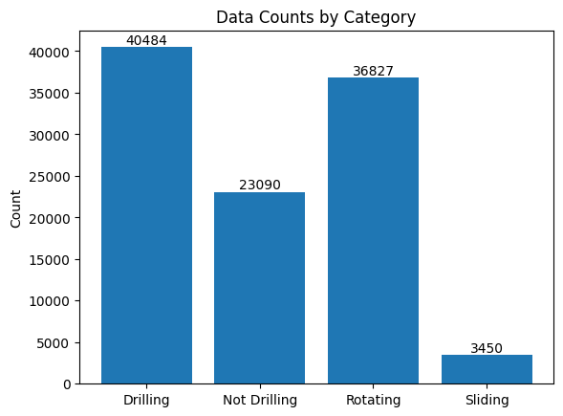
BHA23 Data Exploration

Slide 11
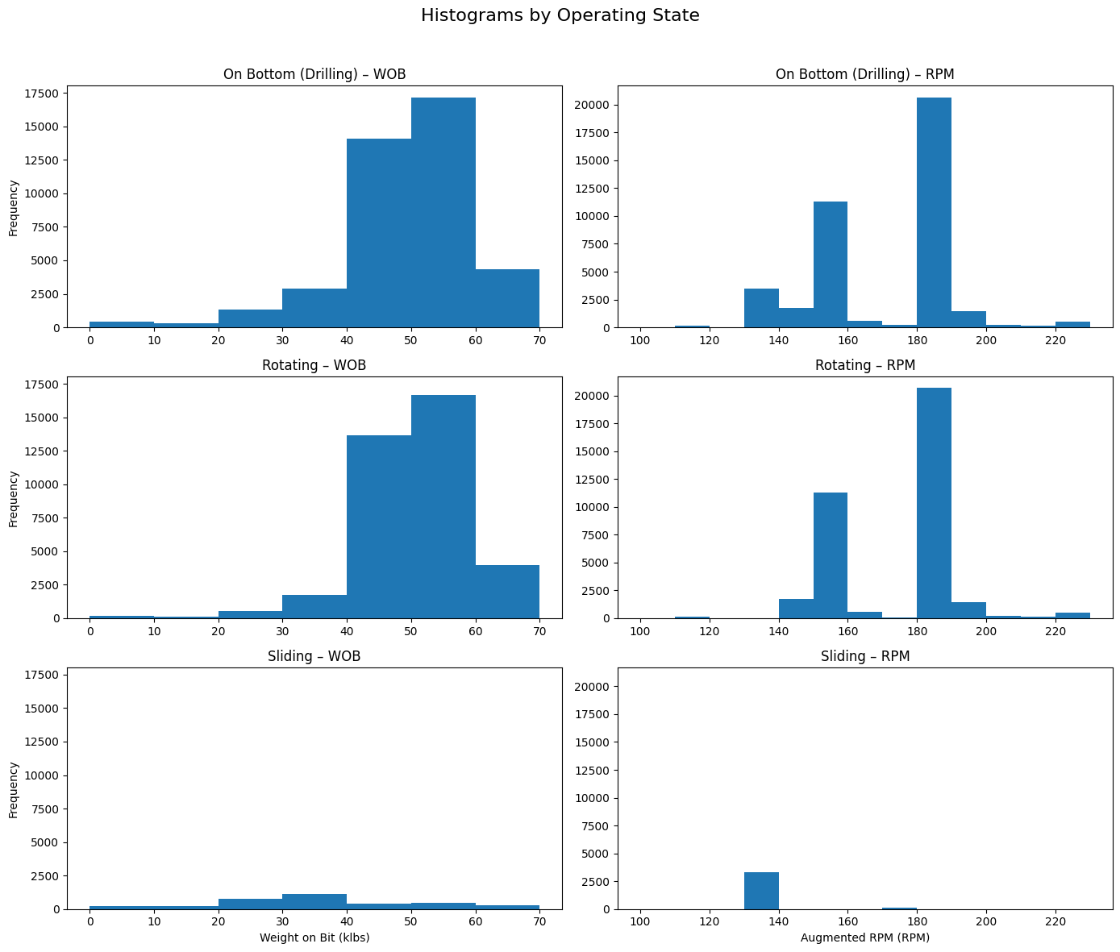
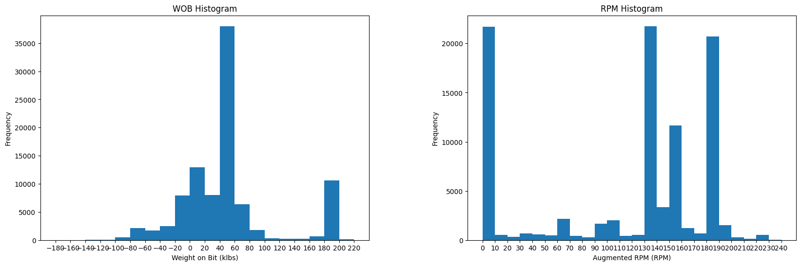
BHA23 Data Exploration

Slide 12
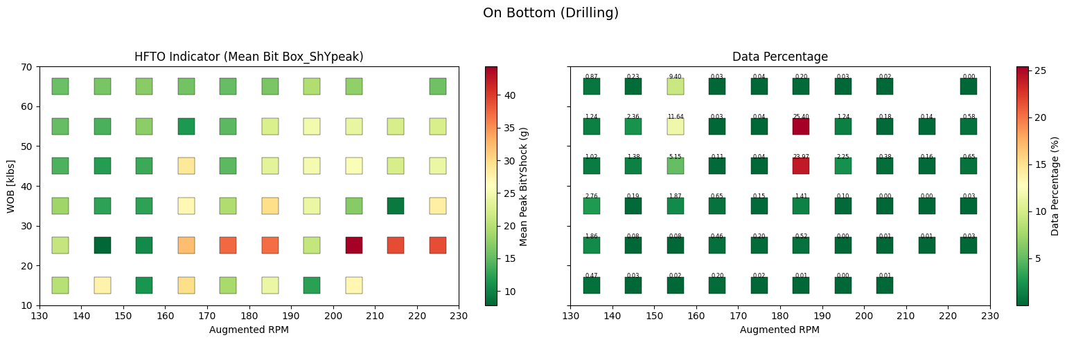
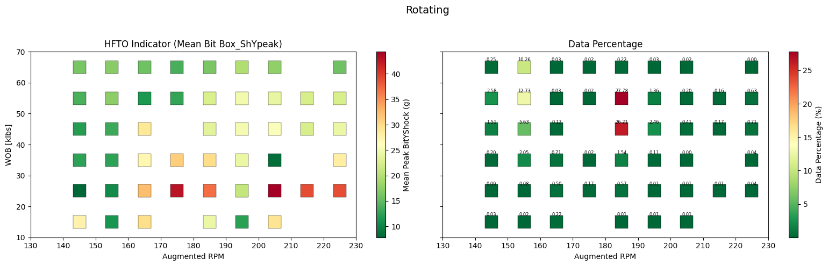
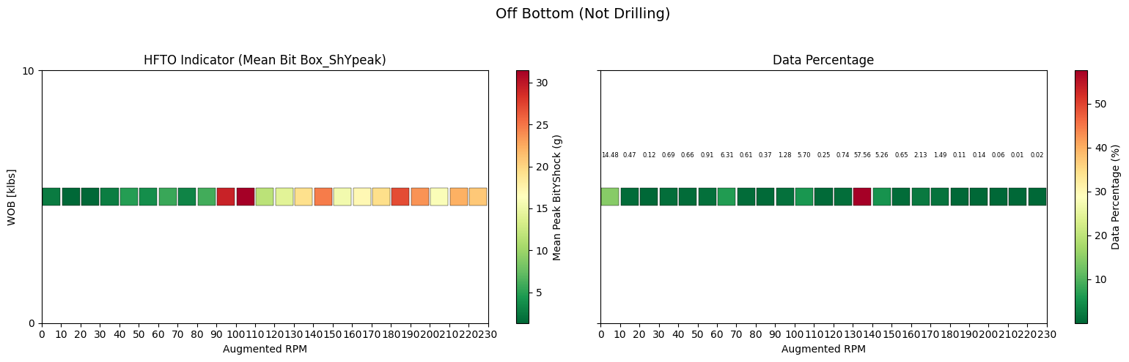
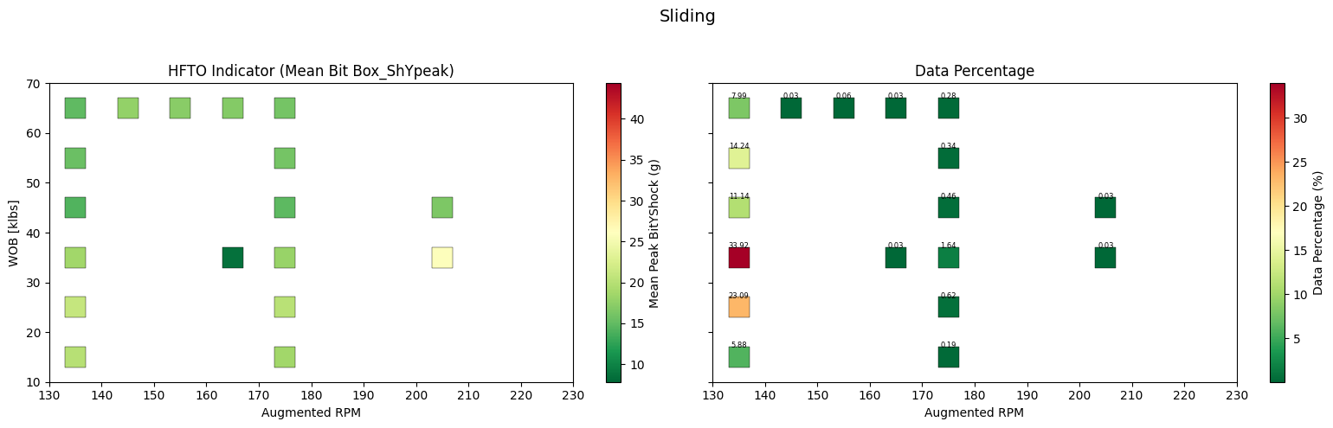
BHA23 HFTO Graphs
Much wider range of drilling data here, but has less samples than BHA18
Decreasing HFTO magnitude with higher WOB additionally RPM past a point also associated with slightly decrease HFTO magnitude (around 210 in this case)
Within the same RPM and WOB bins, rotating has significantly higher HFTO magnitudes than sliding
Similar to BHA18, rotating off bottom above 90 RPM correlated with higher HFTO magnitudes (probably some reaming going off of the data percentage)

Slide 13
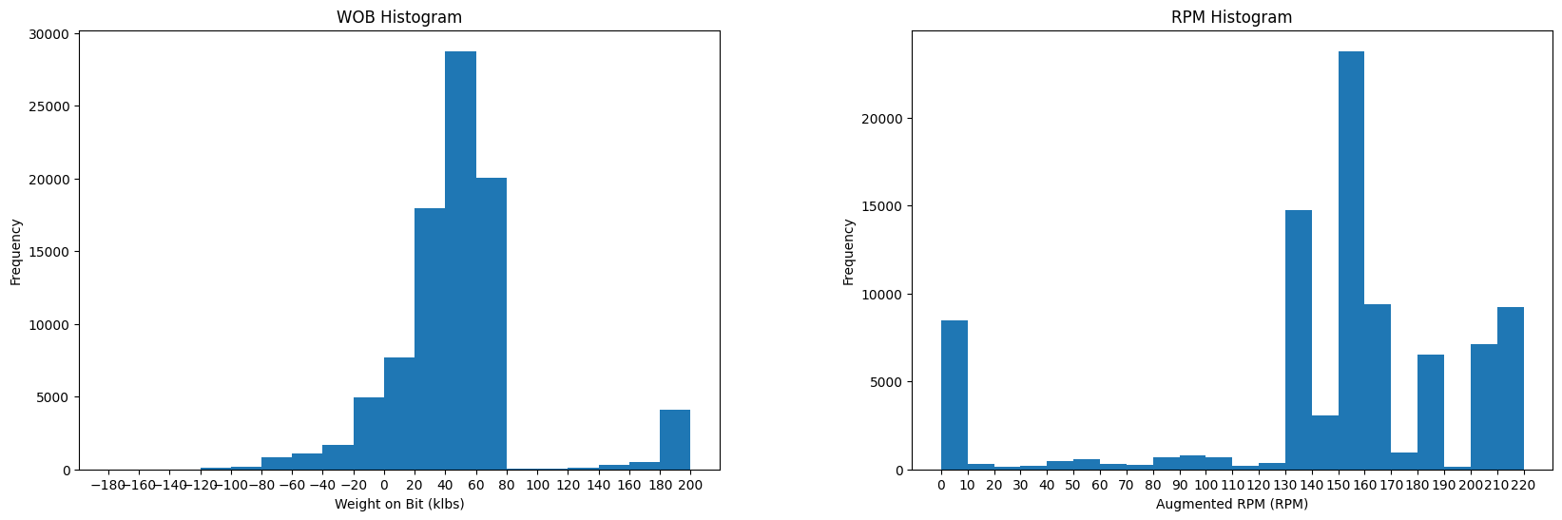
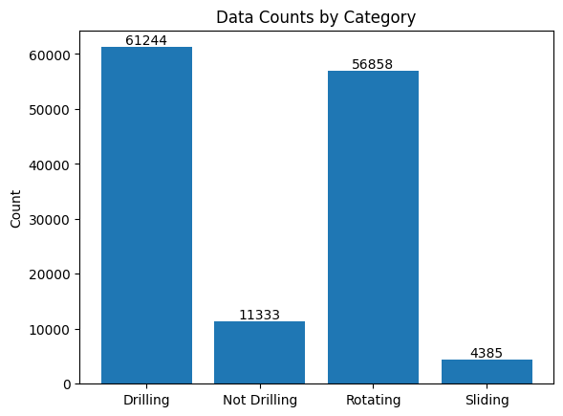
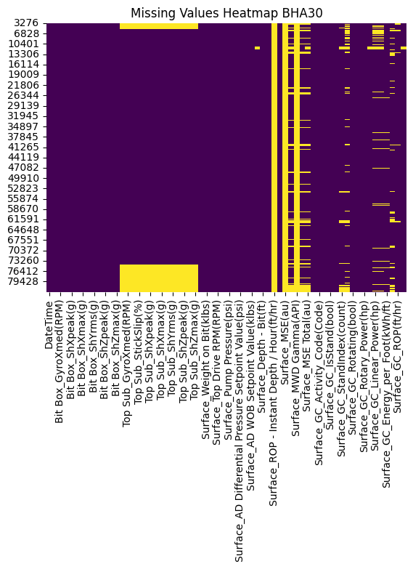
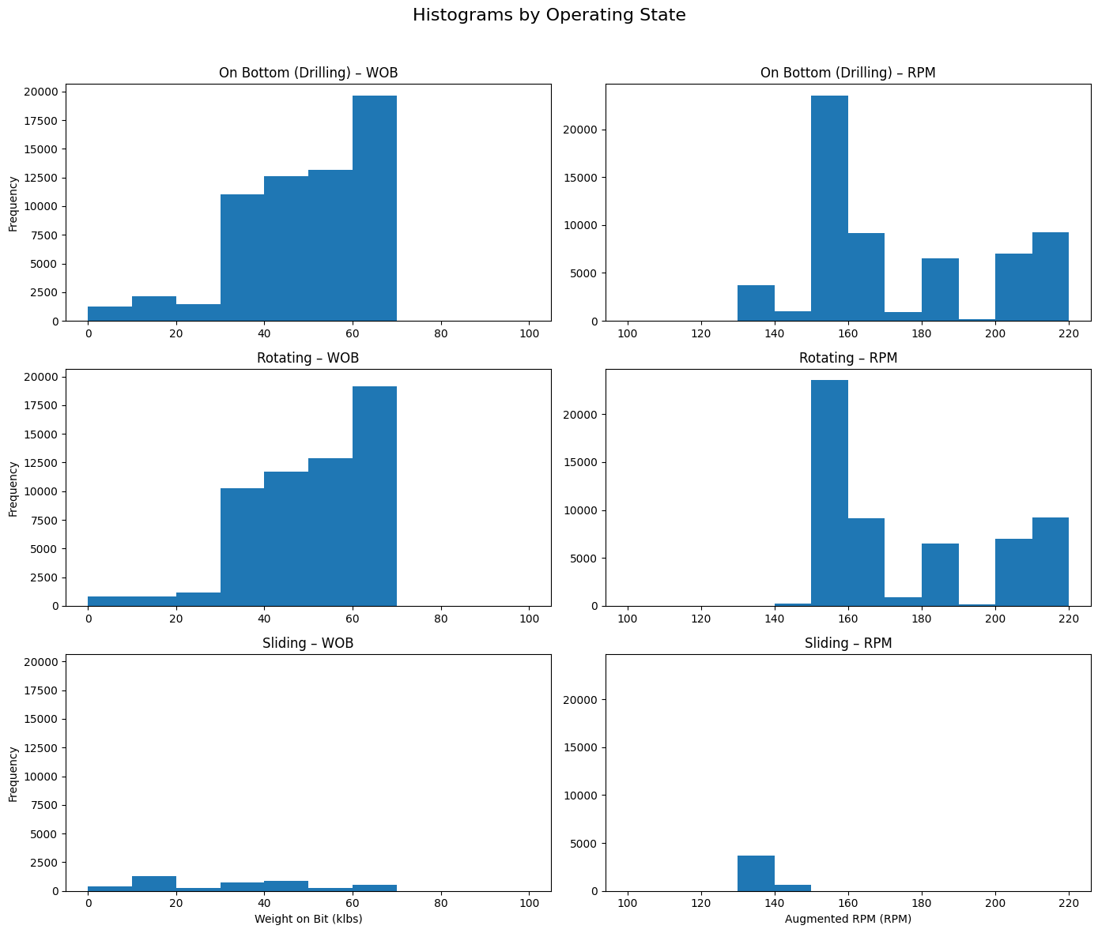
BHA30 Data Exploration

Slide 14
BHA30 Data Exploration

Slide 15
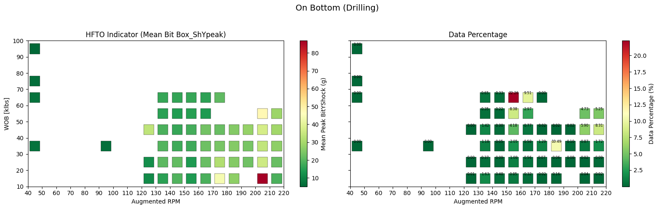
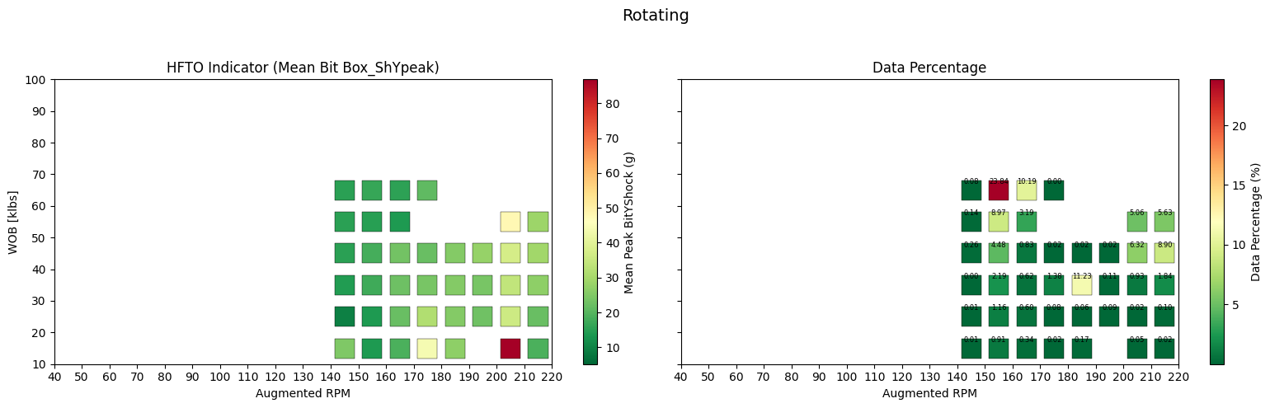
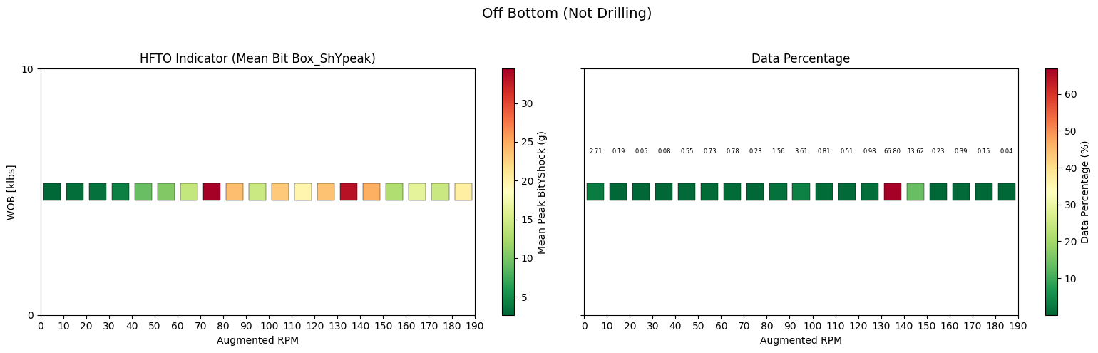
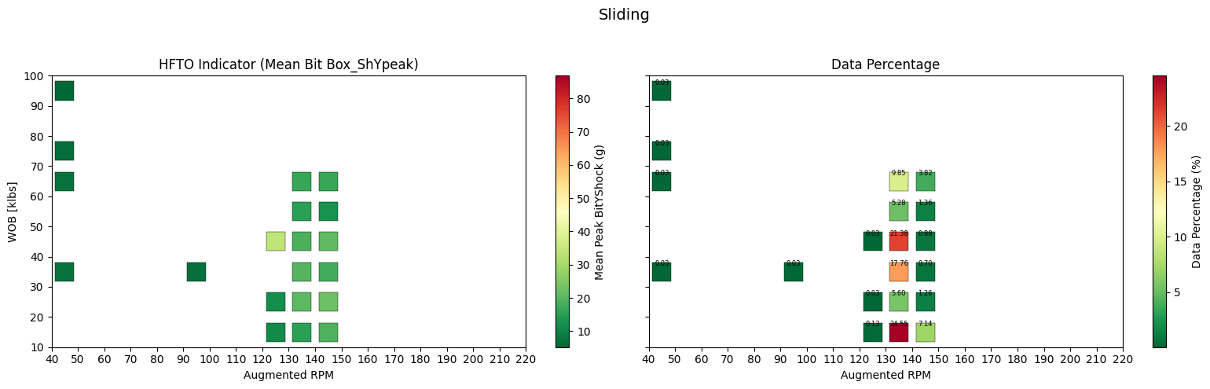
BHA30 HFTO Graphs
Extremely high outliers for this run (about 200 seconds worth of data at , if we remove these the graph looks a lot different
The bottom is rotating with adjusted color bar
Higher WOB associated with lower HFTO magnitudes
Rotating and sliding not a lot of overlap this BHA run
Off bottom rotating has higher associated HFTO magnitude above 70 RPM (probably some reaming going off of the data percentage)

Slide 16
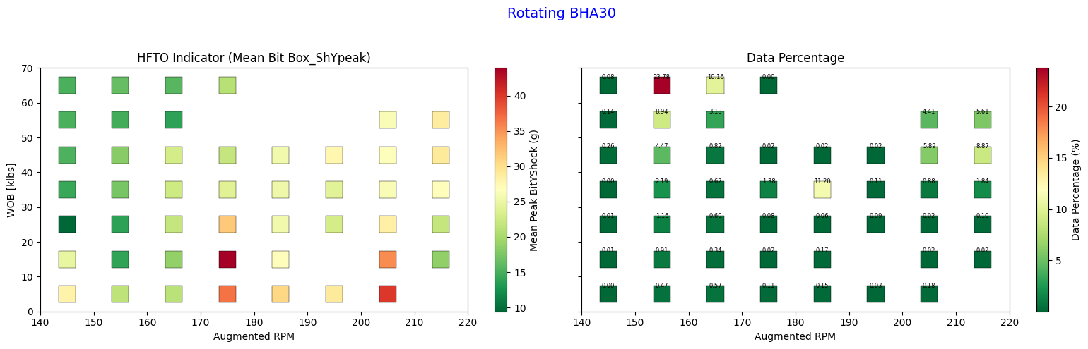
BHA30 HFTO Graph – Outliers Removed

Slide 17
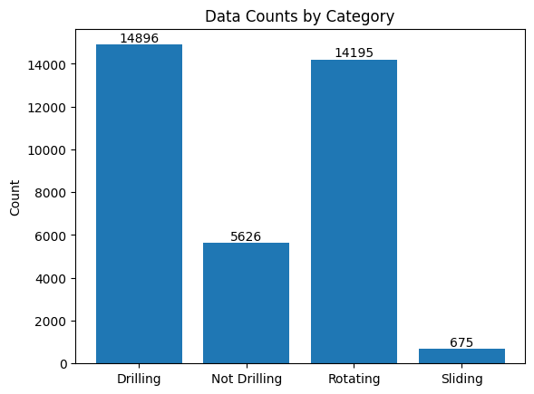
BHA34 (low data) Data Exploration

Slide 18
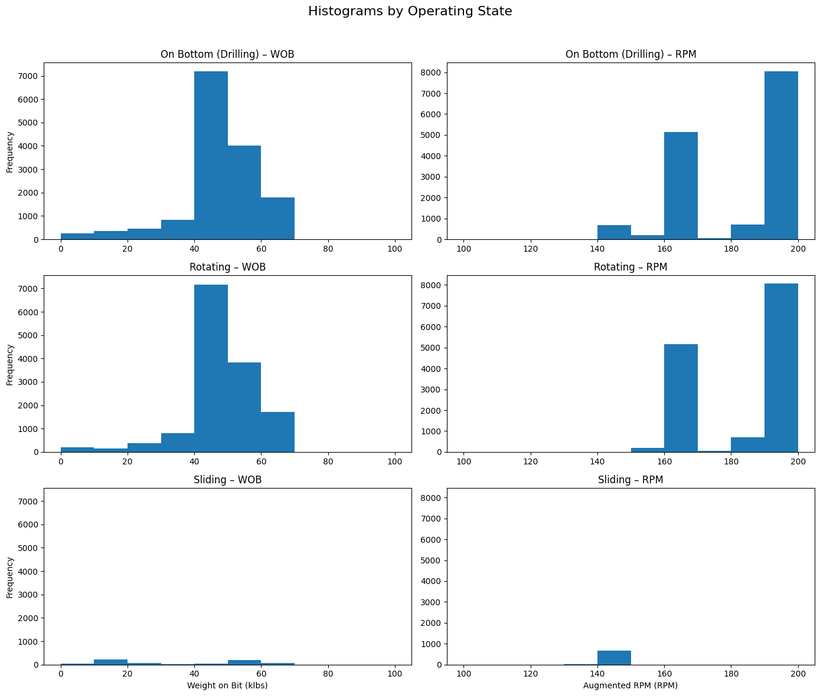
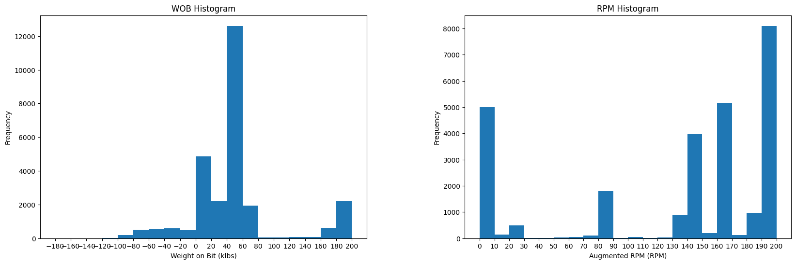
BHA34 (low data) Data Exploration

Slide 19
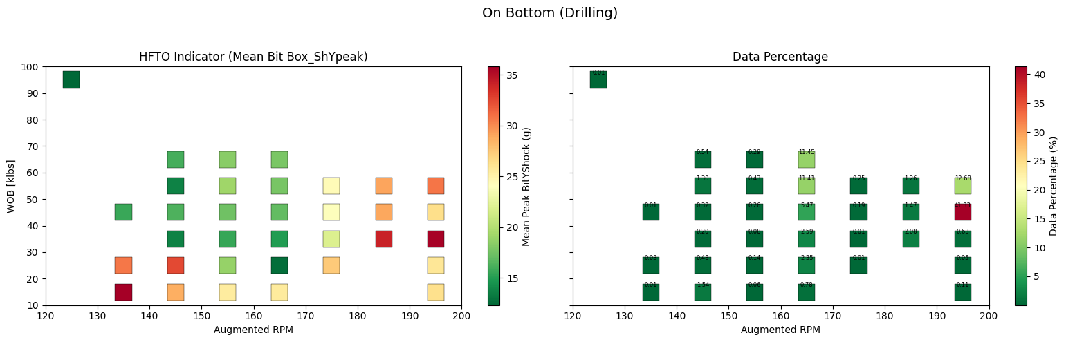
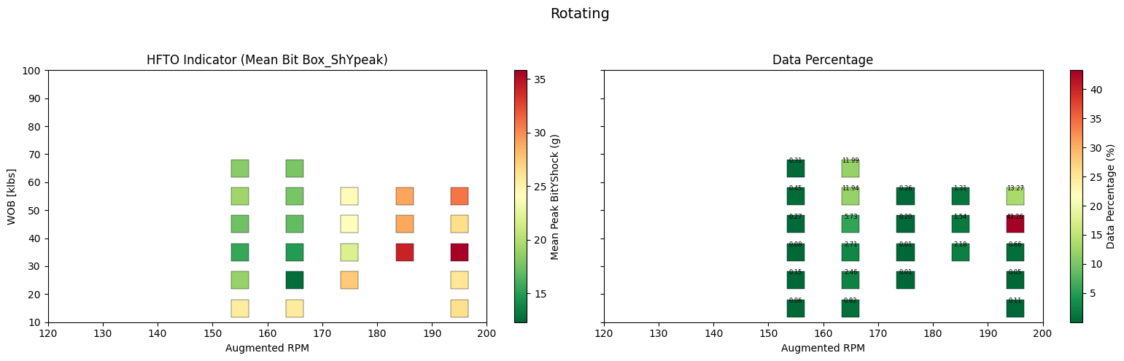
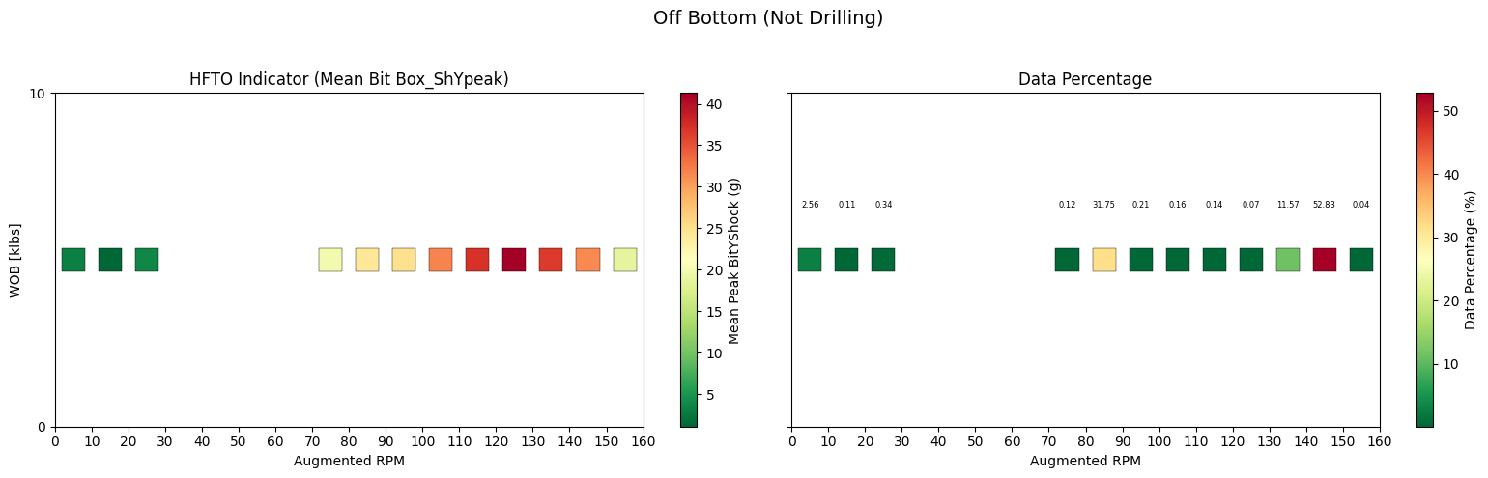
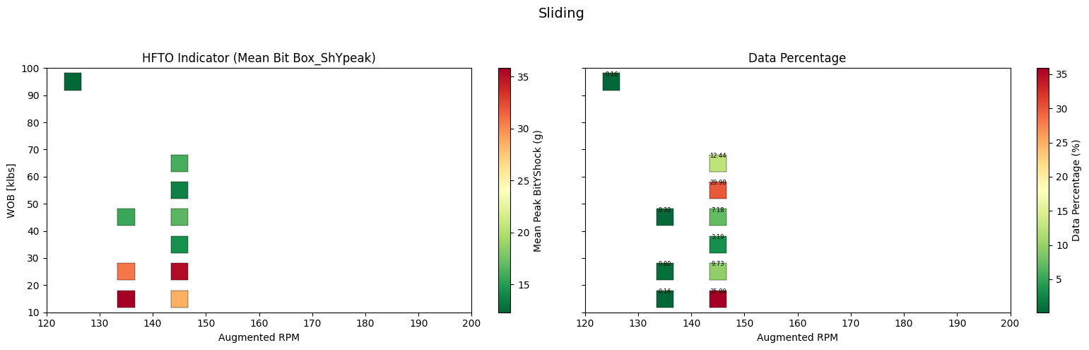
BHA34 HFTO Graphs
Higher WOB associated with lower shocks
Rotating and sliding have no similar WOB and RPM bins
Off bottom rotations see increased shock above 60 RPM (probably some reaming going off of the data percentage)
This BHA has low data

Slide 20
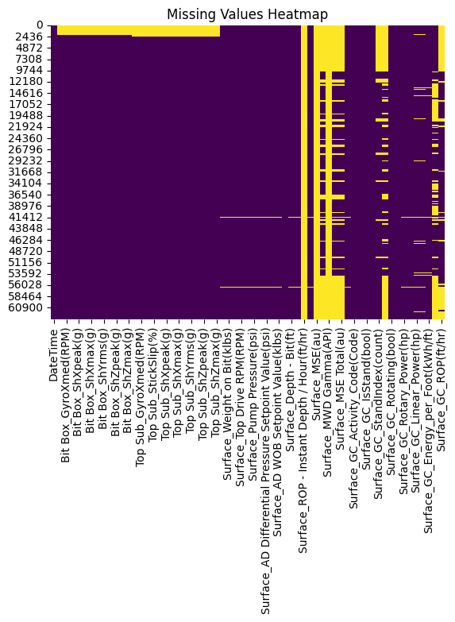
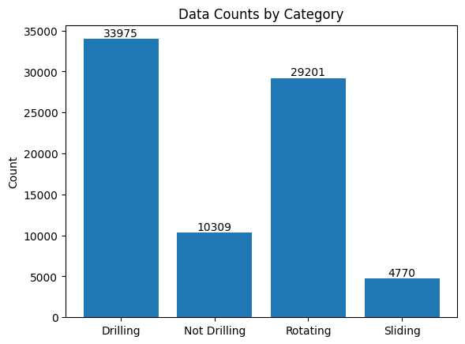
BHA38 Data Exploration

Slide 21
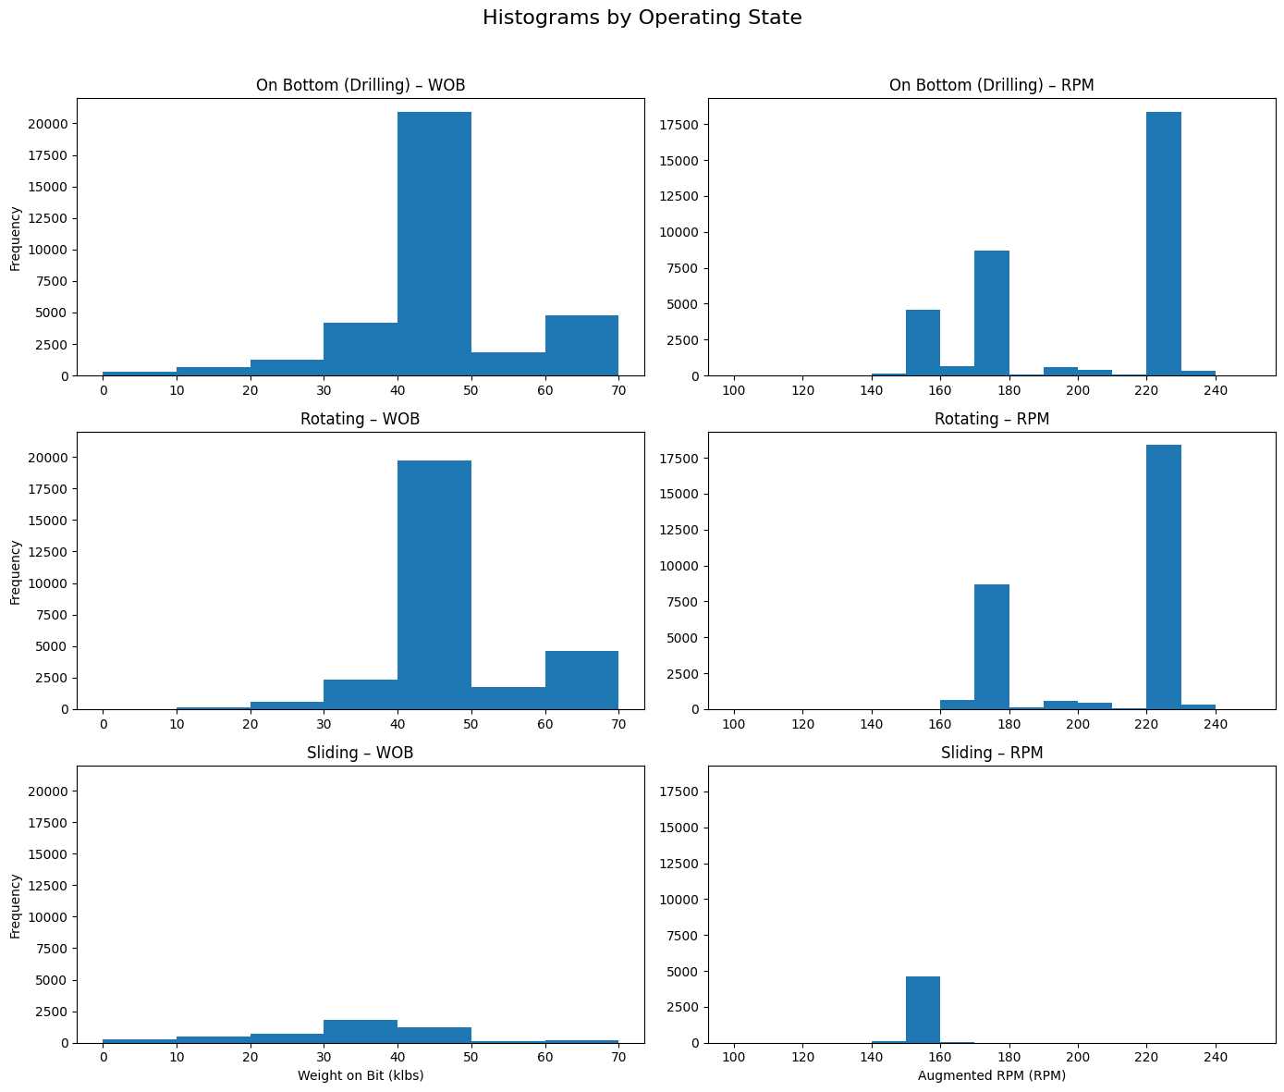
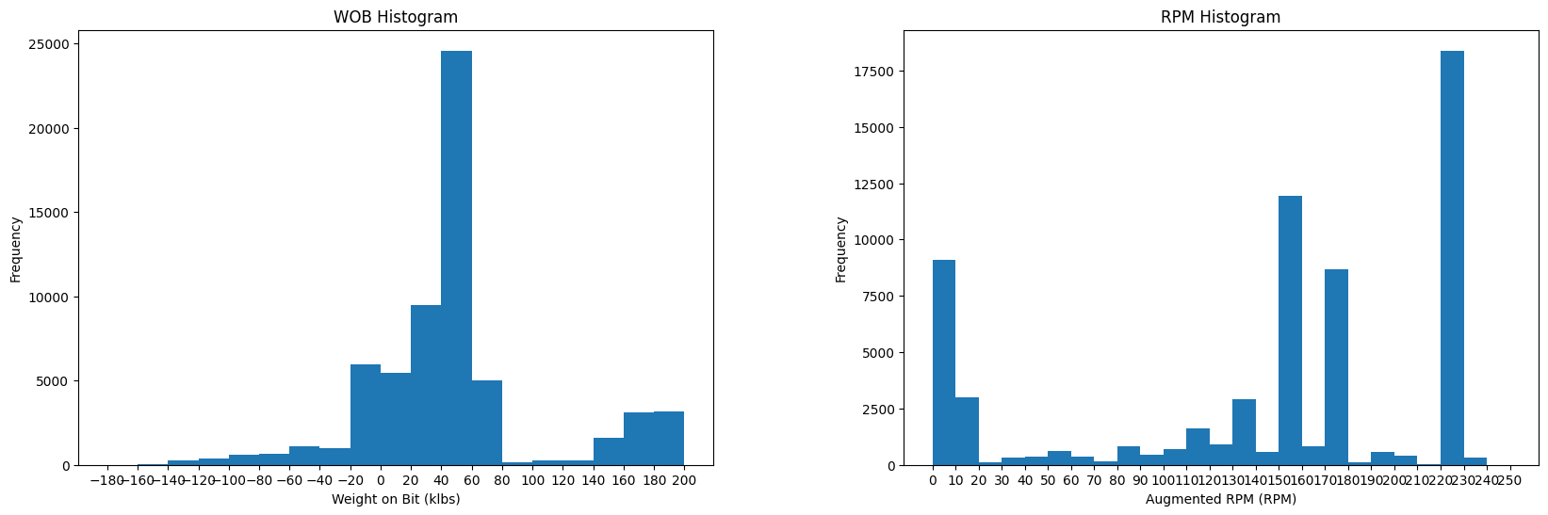
BHA38 Data Exploration

Slide 22
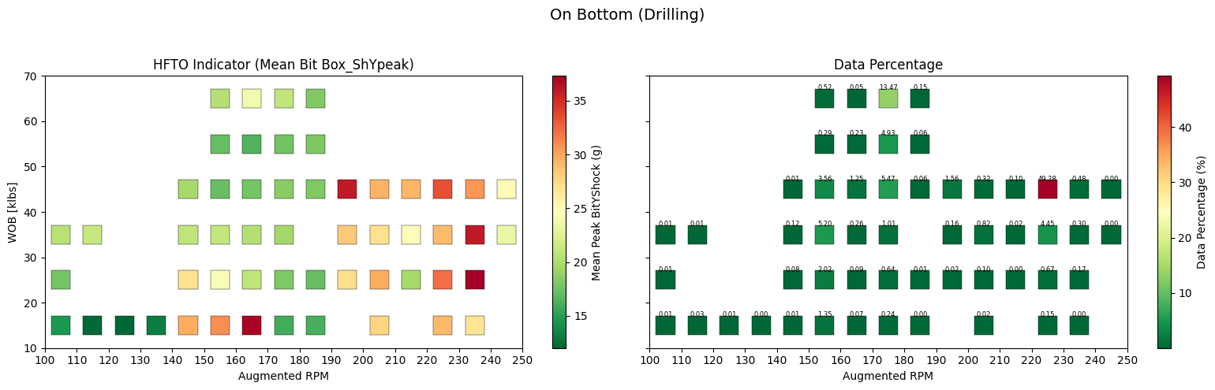
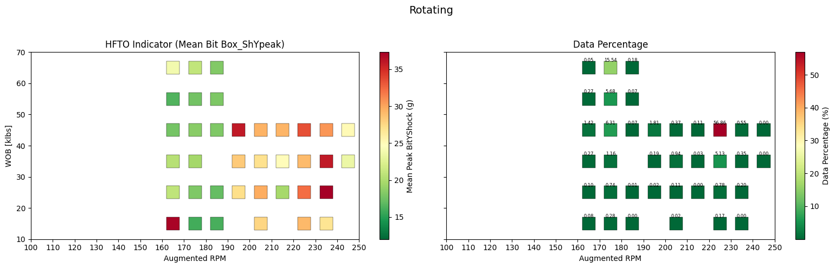
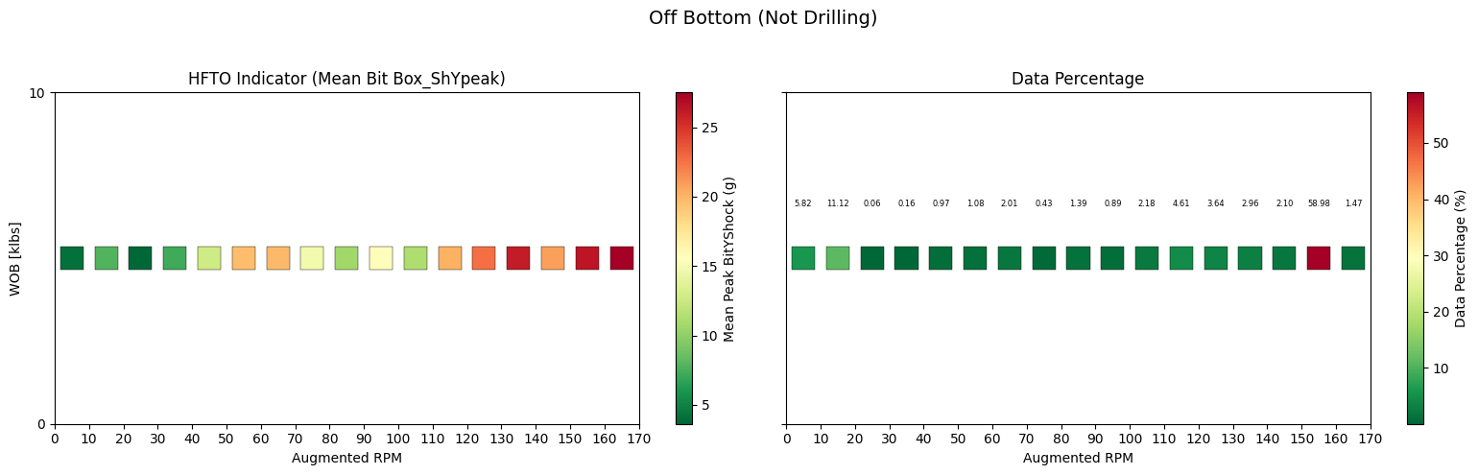
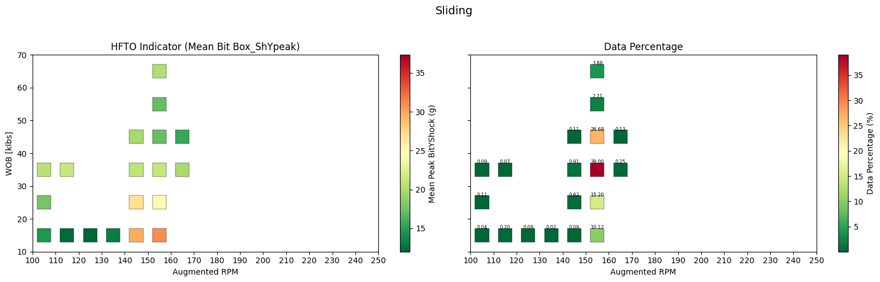
BHA38 HFTO Graphs
For BHA38 we don’t see the same effect of WOB on HFTO magnitude
This could be that we are missing WOB bins > 50klbs
Increasing RPM reduces HFTO magnitudes somewhat past 240
Sliding and rotating don’t have overlapping bins
Off bottom rotations above 110 RPM has increased HFTO magnitudes (probably some reaming going off of the data percentage)

Slide 23
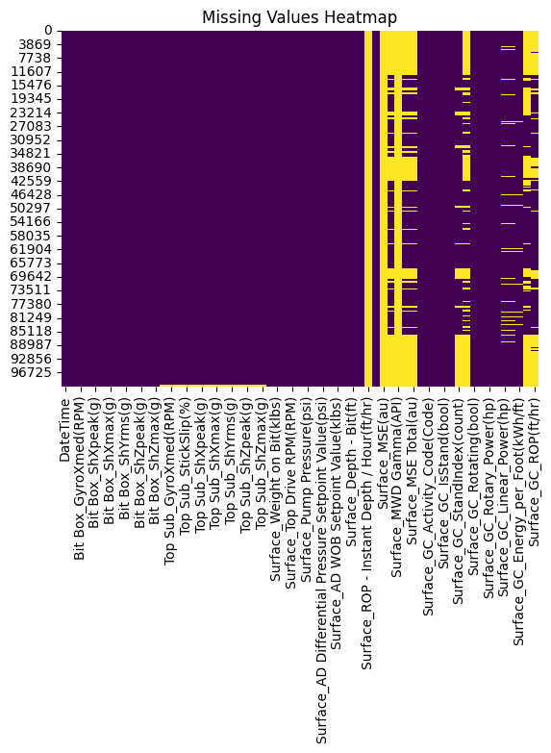
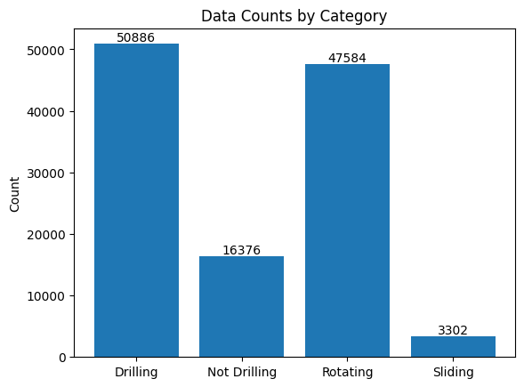
BHA39 Data Exploration

Slide 24


BHA39 Data Exploration

Slide 25




BHA39 HFTO Graphs
Small correlation of higher WOB and reduced HFTO magnitude, we also see higher RPM correlated with reduced HFTO magnitude
When the bins are correlated between rotating and sliding, typically rotating associated with higher HFTO magnitudes
Rotating off bottom sees increased HFTO magnitudes above 100 RPM
WOB 20-30 and RPM 210-220 particularly conducive to high HFTO this run

Slide 26


BHA42 Data Exploration

Slide 27


BHA42 Data Exploration

Slide 28




BHA42 HFTO Graphs
Similar to previous BHA’s we see a correlation with lower HFTO magnitudes with lower WOB values
WOB 10-40 and RPM 200-210 seems particularly conducive to HFTO’s for this BHA
Sliding and rotating do not share similar bins in this run
Rotating off bottom shock magnitudes around the same as other runs when above 100 RPM, the color bar is shifted for this run

Slide 29

Zhang, Y. (2025). HFTO and Bit Design Analysis in Utah Forge Well 16A,
University of Texas at Austin. https://utexas.box.com/s/7dyfz4u8rwj8ug8jrvetst5vm4mnimlm

Slide 30




Red BHA Comparison
For the red BHA’s we see that RPM < 190 and WOB < 50 klbs have significantly higher HFTO’s
Interestingly for BHA23, RPM’s that exceed 190 and WOB that exceed 50klbs have reduced HFTO magnitudes, this data unfortunately doesn’t exist for the other BHA’s
In addition, HFTO magnitudes seem most severe from 200-230 RPM but drop off when pushed even higher
Higher WOB seems to have a suppression effect on the bit vibrations and higher RPM’s may be leading to smoother changes in geology due to faster ROP, reducing effects. (whereas RPM’s where HFTO’s are higher may be due to increased aggressiveness and bit agitation)
For these BHA’s we see that WOB from 10-50 and RPM 200-220 particularly conducive to high HFTO magnitudes

Slide 31

Blue BHA Comparison
BHA30 has some particularly high shock with peaks of 130g’s at some time steps, these are around 500 samples and have been omitted to get a better sense of the HFTO data
We see similar patterns to the red BHA’s here, where higher WOB’s are correlated to a suppression effect on HFTO shock
The effect of higher RPM’s are less pronounced in these BHA’s

Slide 32



BHA 18, 23, 35 HFTO Comparison
BHA35 seem to have higher magnitude HFTO’s when compared to BHA18 and BHA23
We see that within the same drilling parameters, BHA35 has higher magnitude HFTO shock when compared to 23
Interestingly, does not display the same magnitude of the suppression effect as 23

Slide 33


WOB Shifting HFTO Magnitude
As discussed previously, high WOB seems to have a suppression effect on HFTO magnitude, this is curious as lab data typically shows the opposite
This may be some area of further research
To the right are screenshots from BHA30 that shows this effect when drilling in the same area

